Slide 1



Slide 2
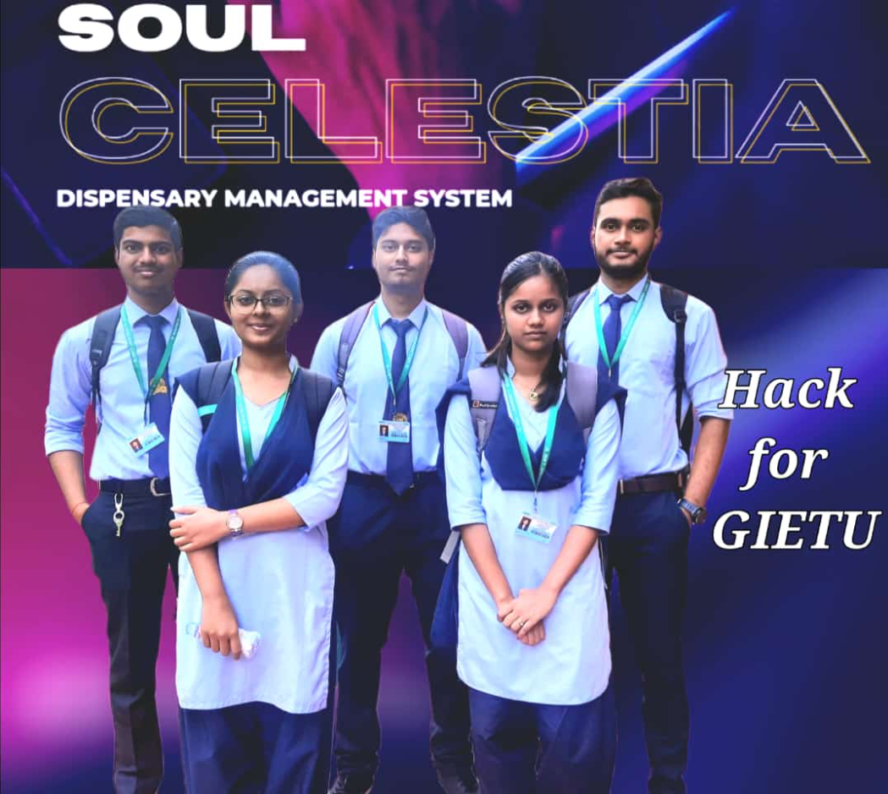
Team Name: SOUL CELESTIA
Team Lead: Ayushman Sahu | 22CSE087
Member 1: Debesh Kumar Behera | 22CSE085
Member 2: Priyanka Panda | 22CSE102
Member 3: Mousumi Mahanty | 22CSE076
Member 4: Abhinash Bharat Jyoti Ratha | 22CSE080

Slide 3
Why did we choose this name?
Soul-The inner part of a person containing his/her deepest thoughts and feelings
Celestia-It is a free space simulator for Windows, Linux, macOS, iOS and Android. You can freely explore space in three dimensions.
we chose this name because, the subject we're basically admitted(or enrolled) in, that is Computer Science and Engineering is what we always dreamt of studying so that we could build based on our deepest thoughts and feelings which is residing in our soul.

Slide 4

OUR TOPIC: DISPENSARY MANAGEMENT SYSTEM
GIET UNIVERSITY, GUNUPUR

Slide 5
What is a dispensary?
A dispensary refers to a small setup with basic medical facilities where a doctor can provide a primary level of care. It does not have a hospitalization facility and is generally owned by a single doctor.
A dispensary is an office in a school, hospital, industrial plant, or other organization that dispenses medications, medical supplies, and in some cases even medical and dental treatment.

Slide 6
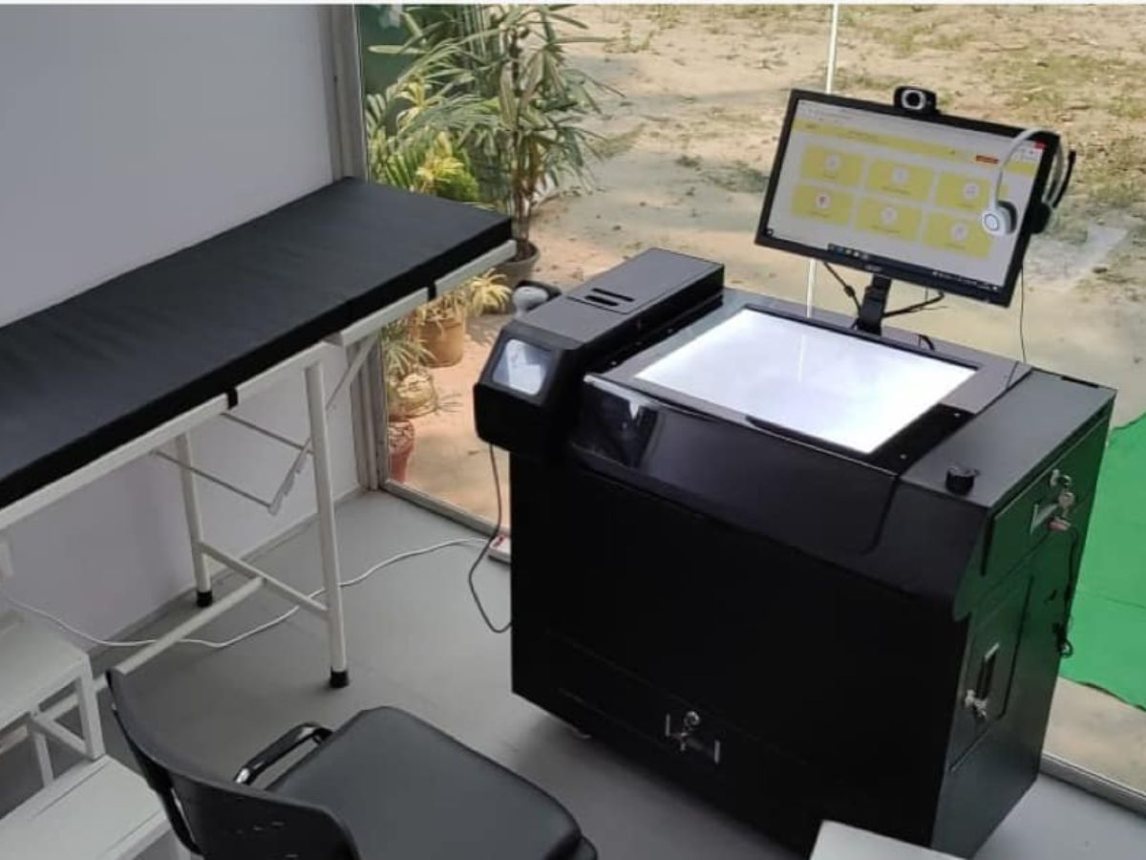
What is a electronic dispensary?
Electronic dispensaries are designed to ensure efficient and consistent dispensing of active ingredients in a secure data environment with full audit traceability. A standard dispensary system consists of a range of modules such as manual dispensing, supervisory, bulk dispensing, recipe management and interfacing with external systems. Such a system might dispense much more than just medical related products, such as alcohol, tobacco or vitamins and minerals.

Slide 7
Advantages:
Achieve good quality ratings.
Better revenue management.
Avoid errors and track every single detail.
Improved clinical decision-making.
Improved data security.
Establishes the dispensary as technical advanced.

Slide 8
Limitations:
Dispense the wrong ingredient.
Dispense the wrong weight.
A computerised system(too much complications in case of a malfunction).
Dispense an invalid lot.
Operator errors.
Contamination of the ingredients dispensed for a product can occur when the incorrect cleaning procedure has been applied following the dispensing of a material.

Slide 9
Conclusion:
Digital signage is a versatile technological solution that yields unlimited benefits for dispensaries. By implementing digital signage in your dispensary and creating creative content, you are on your way to provide an excellent customer support.

Slide 10


